Slide 1
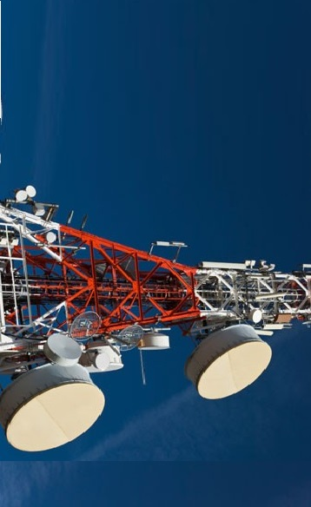

Welcome to
Synergy telecom pvt. ltd.
Synergy Telecom Pvt .Ltd.
www.rfconnector.in

Slide 2
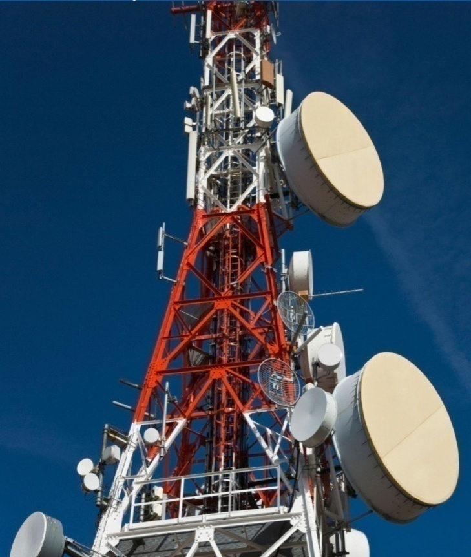
CONTENTS
Introduction
Vision , Mission and Values
Our Products
Financials
Major clients of synergy
Synergy Telecom Pvt .Ltd.
www.rfconnector.in

Slide 3
Introduction
Synergy Telecom, established in 2001 & Private Limited in 2004, is a leading manufacturer, and exporter of IBS and BTS products such as RF Connectors, RF Cable, Microwave, Components, Antennas, Duplexers, Filters, Surge arrestors, Combiner, Attenuator, Installation Kit, Dummy load, Rf Switch, DC-Block and Waveguide Components. We are strong in supplying the material for IBS and BTS installation Products. We are biggest stockiest of the RF component in India. We believe in customer satisfaction and fulfill all their requirements accordingly by improving our product quality.
Synergy Telecom is a diversified technologies company involved in the integration, manufacturing, installation of IBS and BTS sites in India.
Synergy Telecom Pvt .Ltd.
www.rfconnector.in

Slide 4
Meeting Agenda
Vision
Our vision is to be the customers’ first choice and leader in the offerings of stock of all kinds of connectors, cables and microwave components of the shelf solutions and related information to commercial, industrial, contractor, and institutional customers. Our aim is to improve our services up to customer satisfaction.
Mission
Our Strength
We maintain a huge stock to meet all the requirements of our clients. Our good network and healthy professional relationships with reputed companies help us to procure even bulk orders in a short span of time
Superior service and satisfaction for each of our customers
Mutually fair, responsible, and beneficial arrangements with each of our suppliers
Professionalism in all aspects of our business operations
To operate for quality long-term growth while sustaining sound andconservative financial policies
To operate with the highest moral, ethical, and legal standards.﻿
The quality of our cables, antennas and other products are at part with the international standard as we stock products only from the renownedand established companies
Synergy Telecom Pvt Ltdwww.rfconnector.in
Synergy Telecom Pvt .Ltd.
www.rfconnector.in

Slide 5
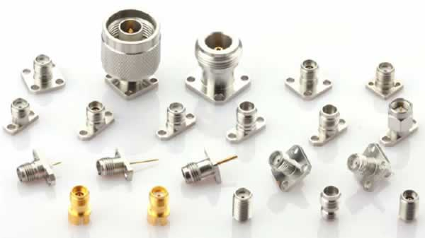
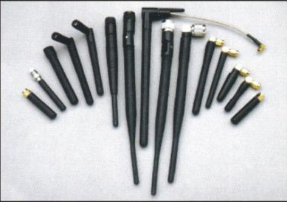
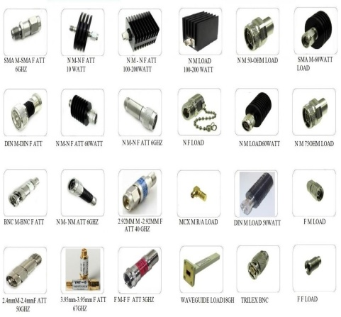

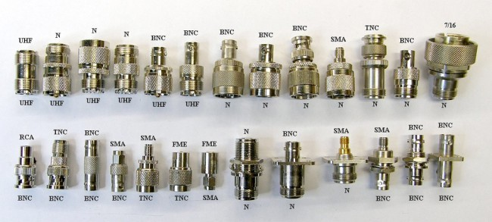
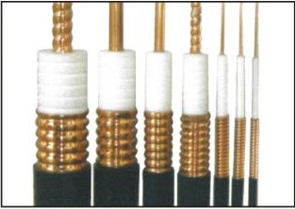
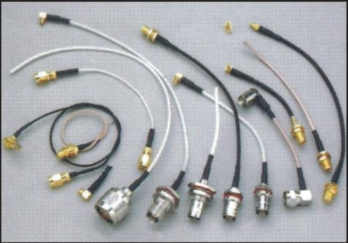
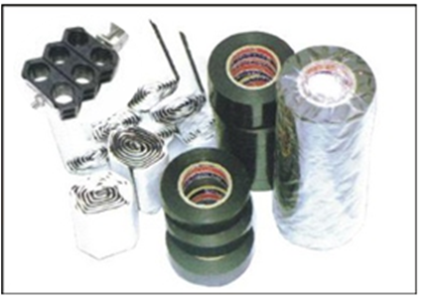
Our Products
RF PRODUCTS
RF Connectors
Whip Antennas
Microwaves
IBS Antennas
RF Adaptors
RF Cables
Cable Assemblies
Installation Kit
Synergy Telecom Pvt .Ltd.
www.rfconnector.in

Slide 6


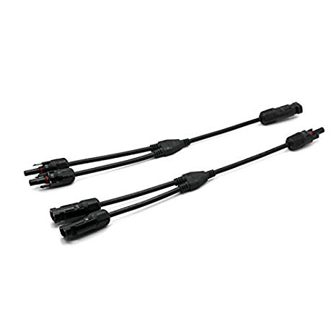
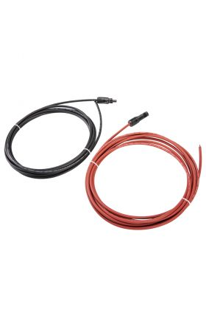
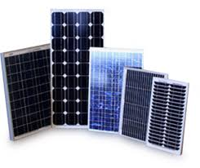


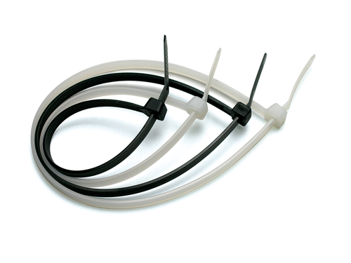
Our Products
SOLAR PRODUCTS
MC4 Connector
MC4 T Branch
MC4 2 in 1
Cable Assemblies
Solar Panels
Solar Cables
MC4 Wrench & Tools
Cable Ties
Synergy Telecom Pvt .Ltd.
www.rfconnector.in

Slide 7
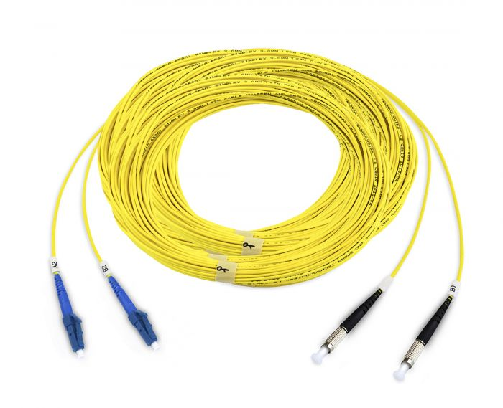
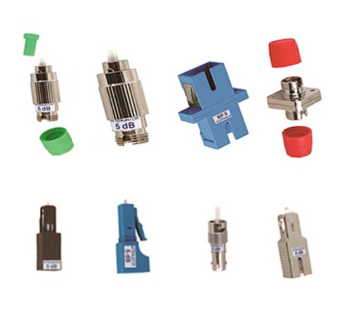
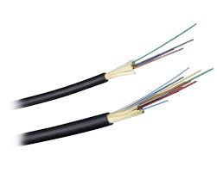
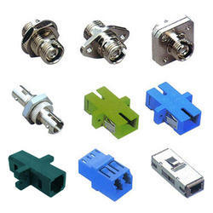
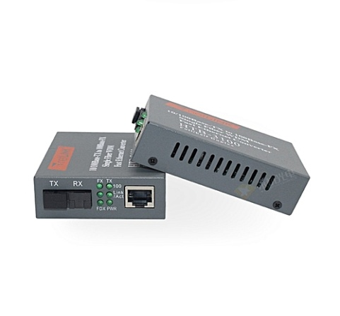
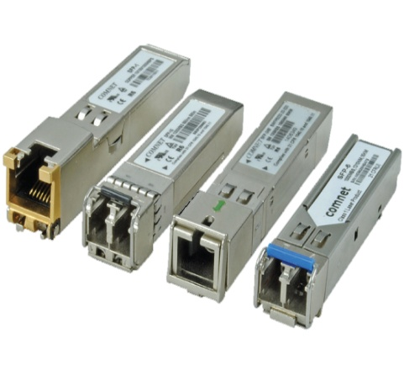
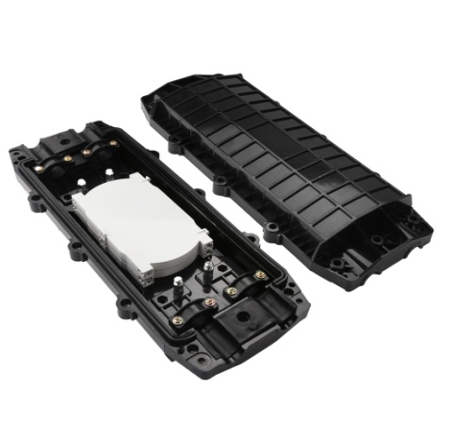
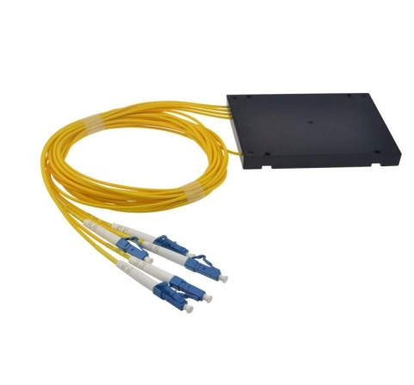
Our Products
OPTICAL PRODUCTS
Patch Cords
Optical Attenuators
Optical Cables
Optical Adaptors
Media Convertors
SFP
Joint Enclosure
Optical Splitters
Synergy Telecom Pvt .Ltd.
www.rfconnector.in

Slide 8
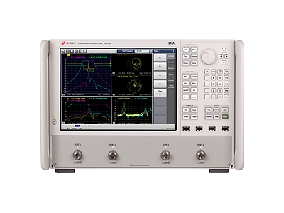
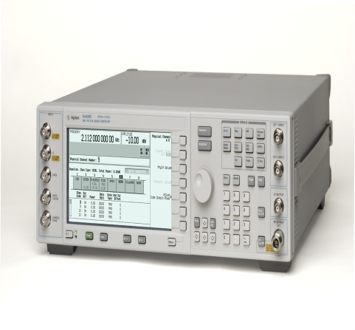
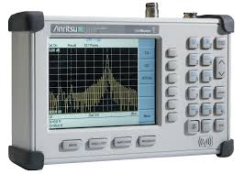
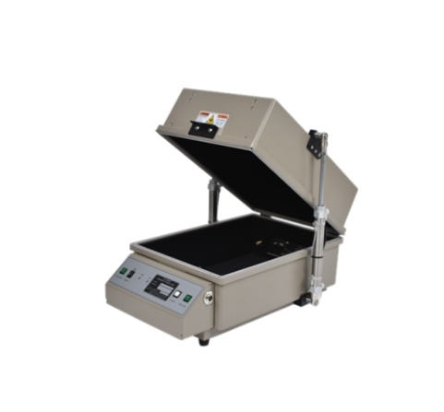
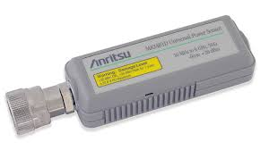

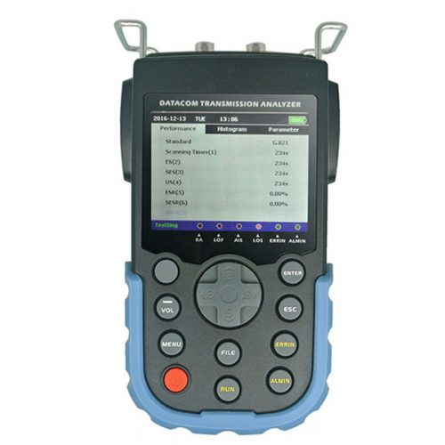
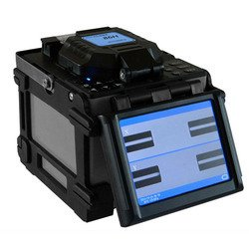
Our Products
TESTING & MEASUREMENT
Network Analyzer
Signal Generators
Site Master
Shield Box
Power Sensor
Cable Fault Locator
BER Tester
Splicing Machine
Synergy Telecom Pvt .Ltd.
www.rfconnector.in

Slide 9

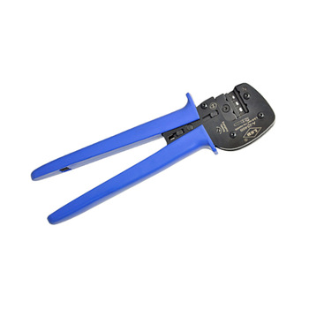





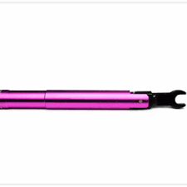
Our Products
TOOLS
Coaxial Crimping Tools
Solar Crimping Tools
Cutting Tools
Stripping Tools
Communication Tools Kit
Telecom Tools Kit
Solar Tools Kit
Torque Wrench
Synergy Telecom Pvt .Ltd.
www.rfconnector.in

Slide 10

A GLANCE OF SYNERGY
Products
Solutions
Service
A glance of Synergy
“ Customer satisfaction is our highest priority, and we never
fail to exceed the customer’s expectation’s !! ”
QUALITY
WARRANTY
02
04
Synergy
01
03
05
PRODUCTS
SUPPLY ON TIME
CUSTOMER SATISFACTION
Synergy Telecom Pvt .Ltd.
www.rfconnector.in

Slide 11
WHAT DRIVES THE NEED FOR IBS?
Demand of Continuous coverage
Indoor activities Generating high traffic
Poor indoor coverage of outdoor sites
Offloading outdoor cells with high utilization
Improvement of Network Performance
Synergy Telecom Pvt .Ltd.
www.rfconnector.in

Slide 12
FINANCIALS
(In crore)
Synergy Telecom Pvt .Ltd.
www.rfconnector.in

Slide 13


























MAJOR CLIENTS
And many more…….
Synergy Telecom Pvt .Ltd.
www.rfconnector.in

Slide 14
Thank-You!!
Synergy Telecom Pvt Ltd
Synergy Telecom Pvt .Ltd.
www.rfconnector.in

